Slide 1
Defined Contribution and The Private Exchange
Mel Diaz – Area Sr. Vice-President, Arthur J. Gallagher
Cathy Lauria – CSBO, West Northfield SD #31
Kaleb Holt – Account Executive, Arthur J. Gallagher

Slide 2
Challenges Facing School Districts
Lack of plan choices for employees
Budget
Promoting Consumerism
Manual Process/Administrative Support
Lack of Decision Tools for Employees
On-line decision support
Economic Pressures from local Community

Slide 3
West Northfield Experience/Process with Insurance Budgeting
Considerations:
Culture
Expectations
Effect on Compensation Package
Level of Satisfaction
Outlook towards Change

Slide 4
Surveys
Employees:
Consider Health Insurance as Most Important Benefit
Prefer Employer Sponsored Coverage
Not Confident in Choosing Plan

Slide 5
D31 Control Costs - CBA
1st year – Determine Board Amount
Subsequent Years – Board’s single health insurance contribution shall be increased by the lesser of: 1) the actual increase in single PPO health insurance premium, or 2) eight (8) percent.

Slide 6
Additional Language
Any remaining insurance premium not covered by the Board’s contribution shall be the responsibility of the teacher. As mutually agreed, any increase in health insurance premiums from one year to the next may be mitigated by adjusting the plan’s benefits through the joint union/district insurance committee.

Slide 7
Considerations for Change
Current
Benefit Structure
Defined Contribution
with Private Exchange
Salary/Benefit relationship
Affects all eligible employees
No culture change
Minimal employee engagement
Cadillac Plan
Controls Cost
Changes Dialogue to individual employee’s needs
Provides Options
Employee Engagement
Fair Allocation
Decision Support

Slide 8
What is a Private Exchange/Marketplace?
Shopping experience
Medical
Ancillary
Voluntary
Includes benefits administration functionality
On-line decision support

Slide 9
Why Consider a Marketplace Solution?
Proactive Strategy
New Approach
Different Needs

Slide 10
What is Defined Contribution?
The employer gives each employee a set dollar
amount to “shop” for their insurance from a menu of options.

Slide 11
What is Defined Contribution?
Employer designated dollar amount for employee to spend
Equally: Everyone gets the same amount. Budget is divided equally for all benefit eligible employees regardless of employee class or tier of coverage (single, couple, employee + children, or family)
Tiered: Different amounts go to employees based on the level of coverage they select. This can be calculated as simply as single or family or up to four tiers. (single, couple, employee + children, family)

Slide 12
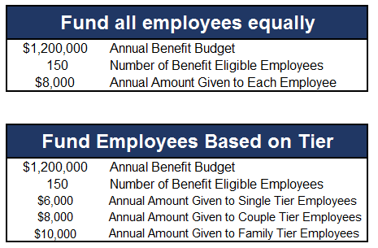
Funding Example

Slide 13
What is Defined Contribution?
Employee spends the money allocated to the employee on benefits
Lump Sum Funding: Employers can put all of the money into a single bucket. Employee chooses benefits and allocation is applied to the total amount of premium for the products they choose. The employee pays the difference between the employer allocation and the total amount due. (see example)
Split Funding: Employers can direct the allocation into multiple buckets. If an employer allocates $8,000 per employee, they may choose to bucket $6,500 to medical insurance, $300 to life insurance and $1,200 to any additional products the employee chooses (see example)

Slide 14
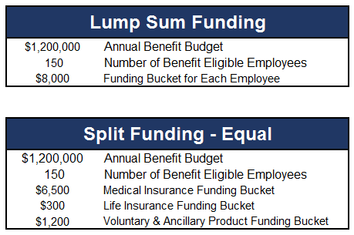
Funding Example
Lump Sum
Split Funding

Slide 15
What does it look like?
 | Deductible | OPX | Coinsurance | Office Visit/ Specialist | Rx
PPO #1 | $500/$1,500 | $1,000/$3,000 | 90% | $20/$40 | $10/$40/$60
PPO #2 | $1,000/$3,000 | $3,000/$9,000 | 80% | $20/$40 | $15/35%/50%
PPO #3 Blue Choice Network | $1,500/$4,500 | $3,400/$10,200 | 80% | $30/$30 | $8/$35/$75 Specialty $150
PPO #4 | $2,600/$5,200 Embedded | $5,000/$10,000 | 80% | 80% after Deductible | 80% after Deductible
PPO #5 | $6,000/$12,000 | $6,350/$12,700 | 80% | 80% after Deductible | 80% after Deductible

Slide 16
What does it look like?
 | OPX | Office Visit/ Specialist | ER | Rx
HMO #1 BA | $3,000/$6,000 | $40/$60 | $250 | $15/35%/50%
HMO #2 BA | $1,500/$3,000 | $20/$40 | $150 | $10/$40/$60

Slide 17
What does it look like?
 | Preventive | Basic | Major | Annual Max | Ortho
Low | 100% | 80% / 50% | Not Covered | $750 | Not Covered
Mid | 100% | 80% / 50% | 50% / 25/% | $1,000 | Not Covered
High | 100% | 90% / 80% | 60% / 50% | $1,500 | 50% up to $2,000 Lifetime

Slide 18
Advantages to Employees
More choice of plans
On-line enrollment
On-line decision and plan comparison tools
Advocacy
Consumer education regarding benefits

Slide 19
Advantages to District
Expands benefit offering to employees
Promotes consumerism culture
Eases administrative process
Predictable Budget

Slide 20

Genoa Kingston’s Journey to the Marketplace

Slide 21
Basic Timeline
Introduction and Proposal
Strategy / Finalization
Implementation
90 days
60 days
45 days

Slide 22
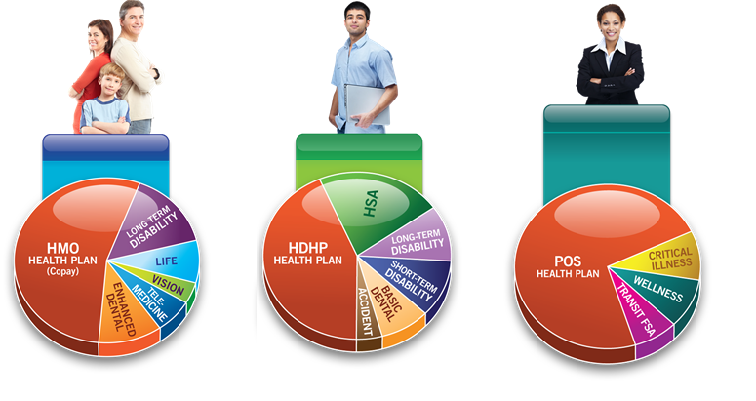
If Done Right…What You Can Expect
80% of people choose a health plan that is NOT the plan they had the year before
90% of the different plans chosen are less expensive
65% of employees choose a HDHP (high deductible health plan)
88% of people who choose a HDHP plan fund the plan with an HSA (Health Savings Account)
When available, narrow-network HMO/PPO plans attract 30%-50% of people
One Year Later…
90% are not planning to make any plan changes in next 2 years
Satisfaction increased
People take control of their insurance choice and their healthcare spend

Slide 23
Key Reminders
Standardization
New World
Time!

Slide 24
Thank You ANY QUESTIONS?

Slide 25
Contact Information
Mel Diaz, Arthur J. Gallagher
mel_diaz@ajg.com
630-285-4195
Cathy Lauria, West Northfield SD 31
clauria@district31.net
847-313-4413
Kaleb Holt, Arthur J. Gallagher
kaleb_holt@ajg.com
630-285-3841

