Slide 1
Jason Randall
JLR@Amazon.com

Slide 2
Why Amazon Business for Education?
Customer Obsession
Your Feedback
Seller Feedback
Amazon’s goal is to help our Education Customers:
Reduce costs & save time
Gain spend transparency & control on Amazon purchases
Meet the needs & preferences of their buyers
Integrate with industry leaders such as Skyward

Slide 3
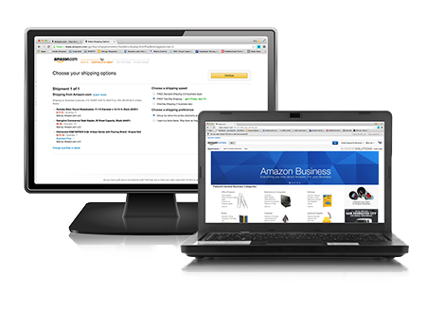
What is Amazon Business for Education?
Centralized marketplace dedicated to education customers and sellers
No cost - simple sign-up
Vast selection
Features and tools to help institutions manage their spend and buy online

Slide 4
The Amazon Business vs. Consumer Experience
FREE Two-Day Shipping on qualifying orders of $49 or more
Amazon Tax Exemption Program*
Tiered administration & centralized reporting
P-card & Purchase Order management & approval workflow options
Fulfillment & returns with dedicated business customer support
U.S. Communities Contract
Optional Punchout / ERP Integration

Slide 5
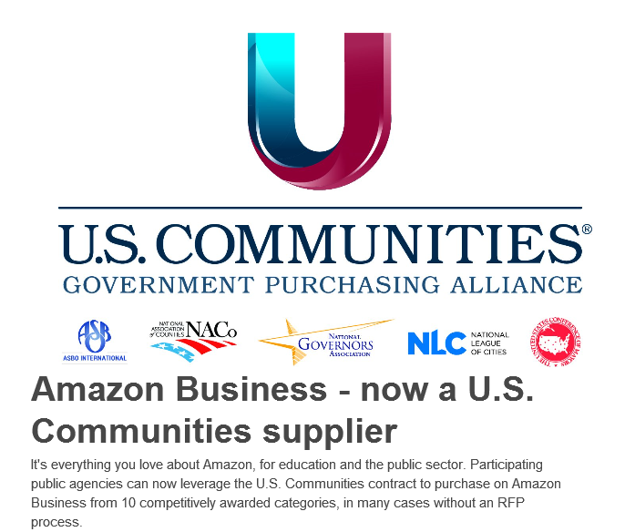
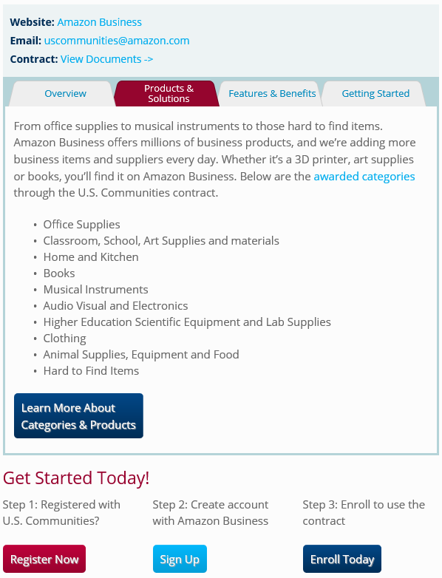
U.S. Communities Contract Overview

Slide 6
U.S. Communities – Process
https://www.amazon.com/b2b/info/USCommunities?layout=landing
Contract Details: http://www.uscommunities.org/suppliers/amazon-business/amazon-business-contract/

Slide 7
Summary
Your Amazon Business for education account offers:
No-cost account creation & implementation
Centralized account benefits and Administrative Tools
U.S. Communities Contract inclusion
Set up in minutes

Slide 8
Next steps
To schedule a personalized consultation contact:
Jason Randall: JLR@Amazon.com

Slide 9
Thank You

