Slide 1
The MacArthur Memorial
Three Leadership Case Studies
Christopher L. Kolakowski
Director

Slide 2
Case Study I: Eighth Army
- Non-verbal communication
- You control the weather

Slide 3
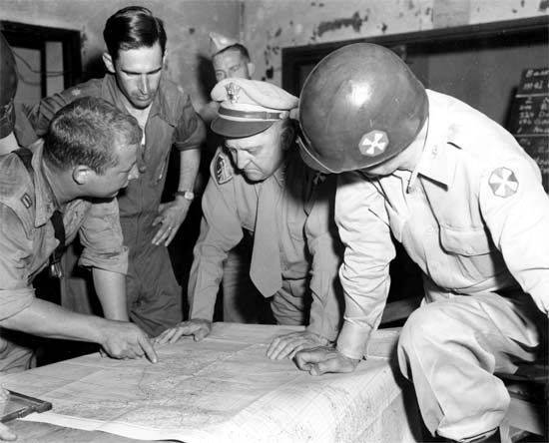

Slide 4
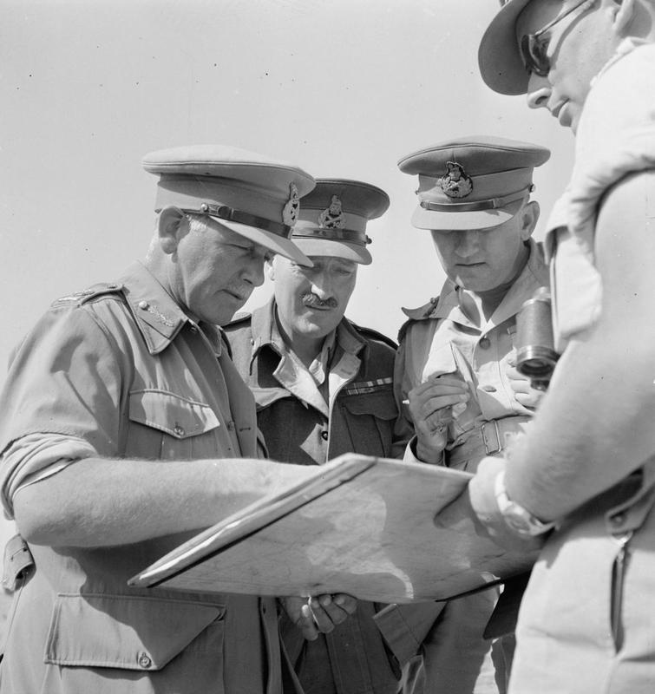

Slide 5
Case Study II: Arnhem
- There are details, and then there are details
- 3 C’s: Communicate, Collaborate, Coordinate

Slide 6
Operation Market-Garden

Slide 7
Objective Arnhem

Slide 8
British 1st Airborne Division, September 1944
Division Commander: Major General Roy Urquhart
Chief of Staff: Lieutenant Colonel Charles B. Mackenzie
1st Parachute Brigade: Brigadier Gerald Lathbury
(landed 17 Sept 44)
4th Parachute Brigade: Brigadier John Hackett
(landed 18 Sept 44)
1st Airlanding Brigade: Brigadier Philip Hicks
(landed 17 Sept 44)

Slide 9
Arnhem Day 1

Slide 10
Arnhem Day 2

Slide 11
Arnhem Days 3-9

Slide 12
Case Study III: The Army Budget
- Setting the strategic vision
- Think broadly and boldly

Slide 13
Key Points
Stockdale Paradox: Confront the brutal facts, but never lose hope you will prevail in the end
Set the vision and plan for victory
Meet immediate targets, but keep larger picture in mind as you set priorities
Do what must be done, but don’t hobble yourself in the long term
Leadership makes the difference

Slide 14
Background
MacArthur US Army Chief of Staff 1930-35
Great Depression raging in US
Army largest part of Federal budget at the time
Significant budgetary pressure
US Army size 132,000 (17th in world)
Global conditions

Slide 15
Army Budgets FYs 1931-35

Slide 16
A Question of Priorities
As budget comes down, what do you cut?
People? Programs? Weapons? R&D?

Slide 17
MacArthur Sets the Vision
“It is necessary also to visualize the existing force as the framework of a much larger war establishment rather than as a balanced fighting unit in itself. Of primary importance in a skeletonized army are those elements not easily extemporized or quickly developed when the emergency arises.”
“Under our system no effort is made to be prepared instantaneously for a major war. Rather, the aim is to accomplish in peace, and as economically as possible, all those preliminary tasks and investigations which will facilitate in an emergency the efficient mobilization, training, and equipping of a citizen soldiery.”
- Douglas MacArthur, 1932

Slide 18
Corollary
“Trained officers constitute the most vitally essential element in modern war, and the only one that under no circumstances can be improvised or extemporized.”
– General MacArthur, 1932

Slide 19
Effects of MacArthur’s Decisions
Leaders of WWII and beyond kept in: Patton, Marshall, Eisenhower, Stilwell, Bradley, Clark, Eichelberger, Krueger, Truscott, Abrams, Westmoreland, Collins, Ridgway, Walker, Patch, Arnold, Spaatz, Doolittle, etc
Weapons of WWII prototyped: Sherman Tank, B-17, P-40, M-1 Garand, .30 cal MG, etc
Initial mobilization plans and basic structure of US Army of WWII set up

Slide 20
Questions
and
Discussion

