Slide 1
Effective Communications in the Business Office
SASBO Annual Conference
April 2018

Slide 2
COMMUNICATIONS
The process by which information is exchanged between individuals through a common system of signs, symbols or behavior.

Slide 3
50-90% of a Manager’s time is spent communicating.
How we communicate helps us to coordinate our actions and achieve goals.
Poor communication can cost money and waste time.

Slide 4
Barriers to Effective Communication
Filtering: Withholding information to manage a person’s reaction
Selective Perception: Personal filtering of what we see and hear to suit our own needs
Information Overload: Occurs when one is to process demands on a timeline when internal calculations exceed the supply or capacity of time available.
Workplace Gossip: Giving greater credibility to the information perceived through office channels when that information could be false.
Poor Listening: Not concentrating on the information being presented.
Biased Language: Stereotyping others on the basis of personal or group affiliation

Slide 5
To be an effective communicator, our body language, appearance, and tone must align with the words we’re trying to convey.

Slide 6
Types of Communication
Verbal Communication: Oral messages that take place on the phone or in person.
Written Communication: Printed messages such as memos, proposals, emails, letters, policies and manuals.
Non-Verbal Communication: Expressions such as body language, eye contact, facial expressions, and posture to express feelings.

Slide 7
Written vs. Verbal Communication
Use Written Communication When…
Conveying facts
The message needs to become part of a permanent file
You do not need immediate feedback
The ideas are complicated
Use Verbal Communication When…
Conveying emotion and feelings
The message doesn’t need to be permanent
You need immediate feedback
The ideas are simple or can be understood easily

Slide 8
Professional Email Etiquette
Be Concise and to the Point
Check spelling and grammar
No Capitalization
No Emoticons or Humor

Slide 9
Business Emails Do’s and Don’ts
Don’t send or forward chain emails.
Don’t put anything in an email that you don’t want the world to see.
Don’t write messages in capital letters – this equates to SHOUTING!
Don’t routinely CC everyone.
Do use a subject line to summarize the message.
Do think of work email as a binding document.
Do end your email with a brief sign off, such as “Thank You” or “Kindest Regards.”
Do let sender know if you’ve received an email in error.

Slide 10
Don’t Use That Tone With Me!
I did not tell John you were late.
I did not tell John you were late.
I did not tell John you were late.
I did not tell John you were late.
I did not tell John you were late.
I did not tell John you were late.
I did not tell John you were late.
I did not tell John you were late.

Slide 11
Communication Freezes
Telling the other person what to do…. “You Must” or “You Cannot”
Attempting to educate the other person…. “The facts are” or “My experience says”
Judging the other person’s actions…. “You’re wrong” or “You’re not thinking right”
Giving insincere praise…. “Well, this is just wonderful” or “Isn’t this great”
Asking inappropriate questions…. “Why did you do that?” or “Who approved that?”

Slide 12
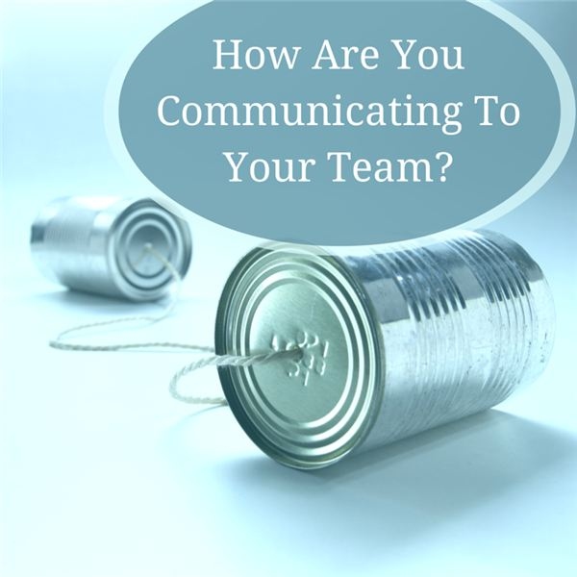

Slide 14
Questions/Comments
Contact Information:
Anya Bailey Randle
Director of Business Services
Assumption Parish School Board
LASBO President
arandle@assumptionschools.com

