Slide 1
The Cost of Protecting Our Greatest Assets
Dr. David Hopkins, Superintendent
Sharon Chuculate, Business Manager
Clarksville School District
Clarksville, AR

Slide 2
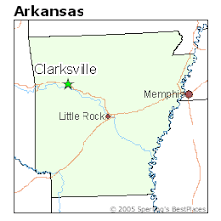
An intro to Clarksville
Sits on I-40 approximately 60 miles from Fort Smith and 100 miles from Little Rock
City population is approximately 9,178 in 2010, up from 7,719 in 2000
Five (5) schools in the district
Approximately 2,560 students K-12
369 Contract Employees
County Tax Revenue for FY 2018 was $7,046,700

Slide 3
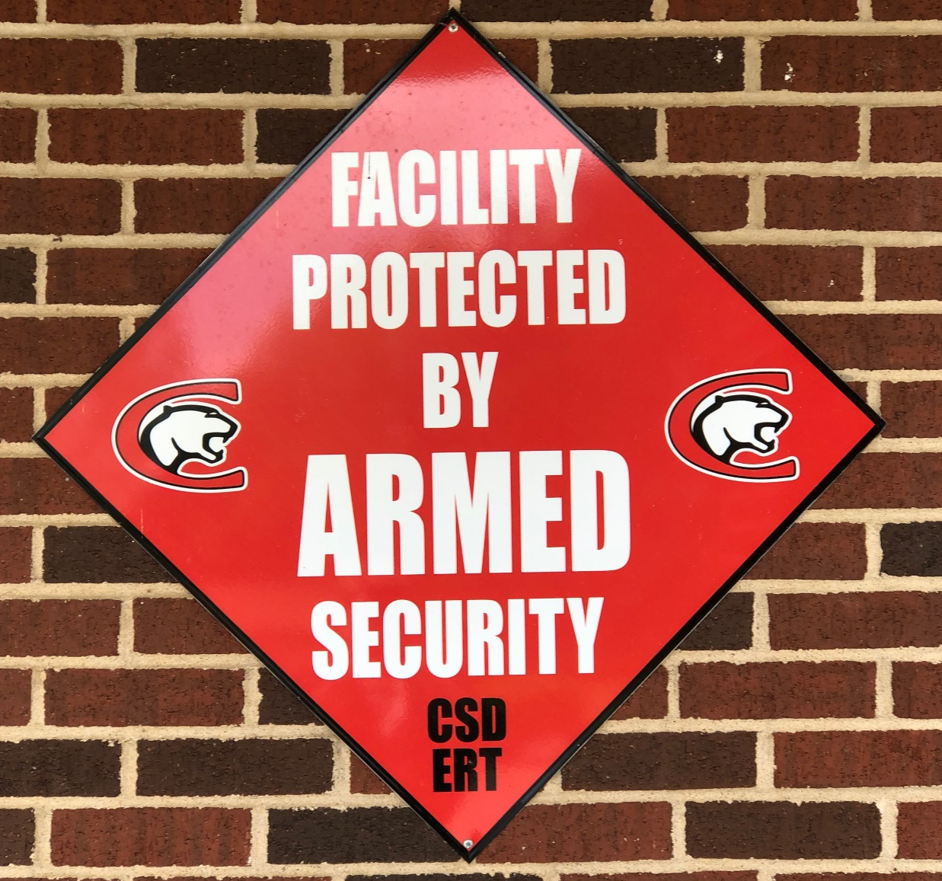
Every building has this sign

Slide 4
And this sticker

Slide 5
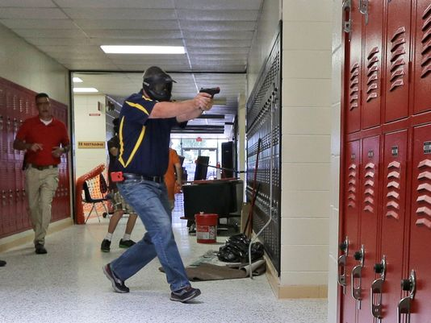
Our Story
Sandy Hook School shooting December 14, 2012
20 students and six staff members died
“We lock the door, and we hide and hope for the best. Well that’s not a plan.”
No Arkansas school district had ever armed the staff; Lake Hamilton School District had for years kept several guns locked up in case of emergency.
22 volunteers in 2013 had 53 hours of training

Slide 6
Costs – Year 1 (2013-2014)
Training for Volunteers - $14,275
ID Printer, badges, lanyards, etc - $4,500
Active Shooter Training for all staff - $900
Signs - $3,000
“Go Bags” - $3,200
Gun Safe - $3,550
Shooting Supplies (Ammo, targets, etc) - $1,200
Psychological Examination on all volunteers - $2,200
Criminal Background Check Fee - $797.50

Slide 7
Costs – Year 1 cont.
Stipend of $1,100 to each volunteer to purchase a firearm
Benefits on the stipend - $238.15 (FICA, MED, Retirement)
$100 allowance each year per volunteer to purchase holsters, etc
Total cost year 1 = $64,315

Slide 8
Year 2
Background Checks - $1,636
Employee Supply Reimbursements - $1,246
Supplies for Training - $24,198
Training - $5,366
Year 2 Total Cost - $32,446

Slide 9
Year 3
Stipends (and benefits) for new volunteers – 6,691
Substitutes (for teachers in training) - $3,321
Training - $28,406
Psychological Evaluations - $500
Background Checks - $741
Employee Supply Reimbursements- $1,228
Supplies for Training - $8,179
Year 3 Total Cost - $49,066

Slide 10
Year 4
Stipend (and benefits) to new volunteers - $8,000
Background Checks - $1,779
Psychological Exams - $1,200
Employee Supply Reimbursements - $1,286
Supplies - $6,984
Training - $13,730
Total Cost Year 4 - $32,979

Slide 11
Year 5
Background Checks - $385
Employee Supply Reimbursements - $1,578
Supplies – 13,852
Substitutes – 284
Training - $31,031
Total Cost Year 5 - $47,130
This year we had two of our employees training to become trainers.

Slide 12
How did we pay for this?
All expenses for ERT (Emergency Response Team) is paid from State and Local revenue.
In 2018 our total ERT expenses were $47,130
In 2018 our total State and Local revenue was $20,715,424
ERT expenses were .228% of our total revenue
The cost to employ just one School Resource Officer can easily exceed $50,000.
For the same amount of money, we have 31 licensed, armed individuals.

Slide 13
How can you put a price on a child’s life?
“As a school superintendent, for me this is not about politics. This is about how we can best protect our children,” Hopkins said.
Most school shooters are students, and when that happens the structural security devices, such as the locked-door systems are not helpful, Hopkins acknowledged. The student is already in the school; you let him in, he said.
With each school shooting, our District fields calls from all across Arkansas, the United States, and the nation.
We are entrusted every day to educate, nurture and keep safe the greatest asset—our students. You cannot put a price tag on that.

Slide 14
Questions & Contact Information
David Hopkins, Superintendent
Clarksville School District
Clarksville, AR
David.Hopkins@csdar.org
479-705-3200
Sharon Chuculate, Business Manager
Clarksville School District
Clarksville, AR
Sharon.Chuculate@csdar.org
479-705-3200

