Slide 1
Internal controls: batten down the hatches
Presented by Stacy Hopkins, CPA
Business Manager
Pangburn School District, Pangburn AR

Slide 2
Agenda
Definitions
Overview
Why Do We Need Internal Controls
Internal Control Framework
Fraud
Implementing Internal Controls

Slide 3
Definitions

Slide 4
Definitions
In-ter-nal - existing or occurring within an organization

Slide 5
DEFINITIONS –
Con-trol – (noun) the power to influence or direct people’s behavior or the course of events
Con-trol – (verb) determine the behavior or supervise the running of; maintain influence or authority over

Slide 6
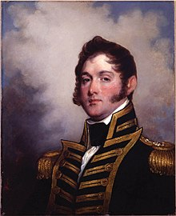
“We have met the enemy and
they are ours.”
Oliver Hazard Perry
US Naval Officer

Slide 7
overview

Slide 8
OVERVIEW
Internal control is a process used by management to help an entity achieve its objectives.
Internal controls helps an entity run its operations efficiently and effectively, report reliable information about operations and
Comply with applicable laws and regulations.

Slide 9
Internal Controls in Everyday Life
Lock-up your house
Balance your checkbook (or monitor your bank account on-line)
Keep your keys in a safe place
Maintain the privacy of your passwords

Slide 10
Why DO WE NEED INTERNAL CONTROLS?

Slide 11
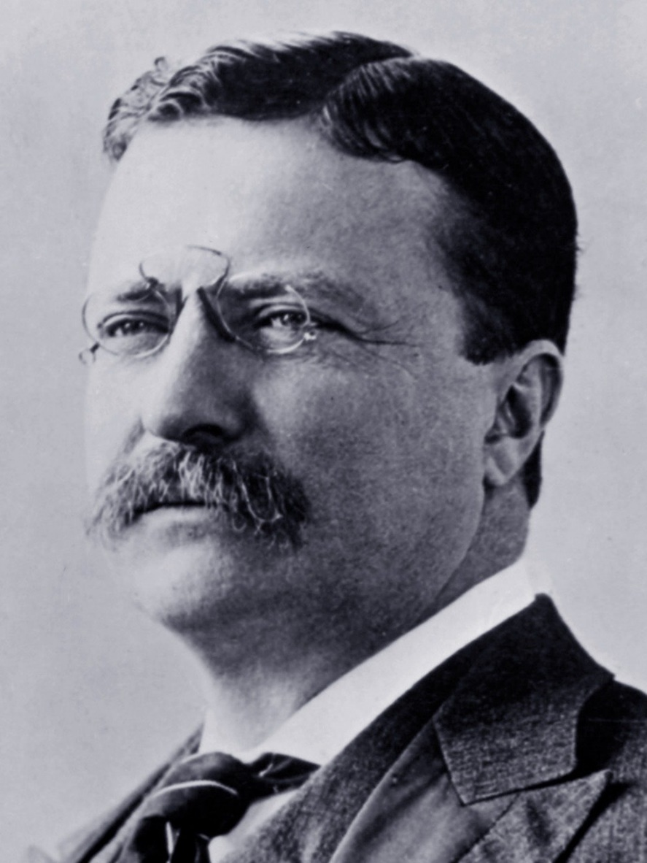
President Theodore Roosevelt
“A good Navy is not a provocation to war. It is the surest guaranty of peace.”

Slide 12
Why do we need internal controls?
Ensure Mission Accomplishment
Provide for Accurate Financial Information
Provide Documentation of Proper Accounting
Ensure Proper and Legal Expenditures/Disbursements
Reduce Opportunities for Fraud
Detect Errors and Fraud in a Timely Manner
Promote Public Trust and Confidence

Slide 13
And PREVENT AUDIT FINDINGS!
“Deficiencies in the internal control component of control activities adversely affected the District’s ability to initiate, record, process, and report financial data in accordance with the regulatory basis of accounting such that there was a reasonable possibility that a material misstatement of the District’s financial statements would not be prevented, or detected and corrected on a timely basis. Financial accounting duties were not adequately segregated among employees.”

Slide 14
So What Does That Mean?
Weaknesses in the processes of initiating, recording, processing, and reporting receipts and disbursements could reasonably allow a material false account of the District’s financial statements, and
Those inaccuracies would not be detected or corrected on a timely basis

Slide 15
Why Does This Matter?
Waste of School Assets
Inaccurate or Incomplete Information
Loss of Future Grants and the Required Repayment of Funding
Loss of Public Trust – Dollars Follow the Students
Negative Publicity – Social Media is More Severe than the Local Newspaper
Violation of Laws

Slide 16
Internal control framework
Sources for Guidance

Slide 17
COSO Framework – Private Companies
First published in 1992
Gained wide acceptance following financial control failures of early 2000’s
Most widely used framework in the US
Also widely used around the world

Slide 18
FIVE COMPONENTS OF INTERNAL CONTROL
Control Environment
Risk Assessment
Control Activities
Information and Communication
Monitoring

Slide 19
Control Environment
Promoting an ethical work environment
Controlling the environment is greatly influenced by the extent to which individuals recognize they will be held accountable
Administrative staff and employees are committed to following policies and procedures
Competent people understand their responsibilities (i.e. job descriptions)
Adequate training

Slide 20
Control Environment - Continued
Appropriate disciplinary action when an employee does not comply
Administration is responsible for setting the tone

Slide 21
Risk Assessment
What assets need to be protected?
Where are the vulnerabilities?
Petty Cash * Cash Receipts * Travel Expenditures
Payments to Non-Vendors * Credit Card Transactions
Supplies for Maintenance/Bus Garage * Equipment Purchases
What could go wrong?
How could a theft or fraud take place?
It’s management’s responsibility to be proactive.

Slide 22
General Control Activities
Access Security including data and program security
Physical Security
Software and program change controls
Disaster Recovery

Slide 23
Examples of Control Activities
Approvals, Authorizations, and Verifications (Preventive)
Reconciliations – Bank Statements, External Reports (Detective)
Access to equipment, inventories, and cash is limited. Periodically counted and compared to previous inventory (Preventive and Detective)
Segregation of Duties (Preventive)

Slide 24
Information and Communication
Reliable information in a form and timeframe that is useful
Source of information can be internal or external
Communication can be formal or informal
Input and feedback
Communication as simple as staff meetings can provide input and feedback relative to the LEA’s operations, financial reporting and compliance reporting

Slide 25
Monitoring
The assessment of internal control performance over time
Accomplished by ongoing monitoring activities such as:
Annual evaluation of personnel
Spot check transactions
Self Assessments
Review applicable laws and regulations to ensure compliance

Slide 26
Comparison
COSO
Greenbook

Slide 27
“Green Book” – Standards for Internal Control in the Federal Government 2014 Revision – September 2014
Reflects federal internal control standards required per Federal Managers Financial Integrity Act (FMFIA)
Serves as a base for OMB Circular A-123
Written for government leveraging the COSO Framework and using government terms

Slide 28
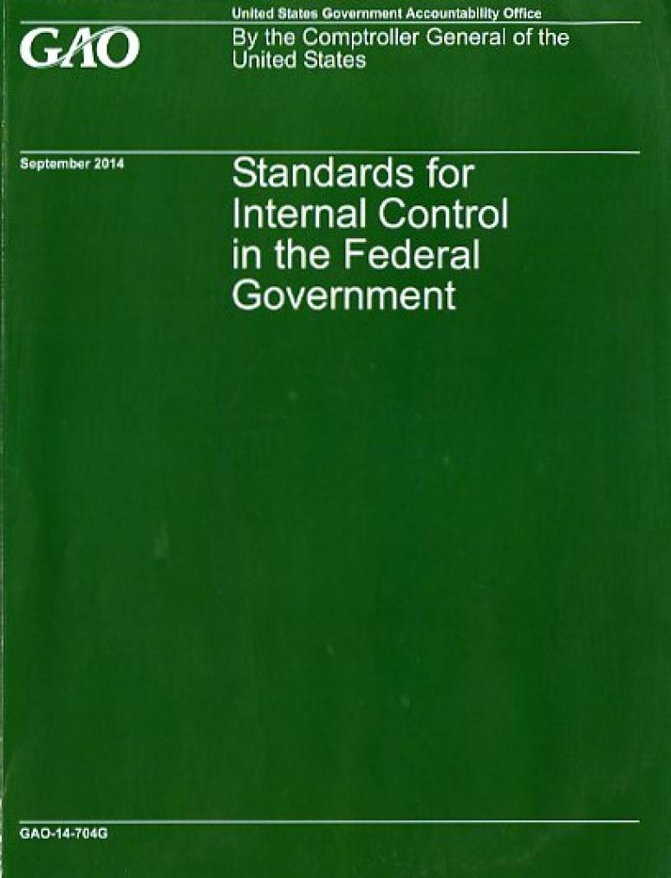
“The Greenbook”
www.gao.gov/greenbook

Slide 29
A Smooth Sea Never Made a Skillful Sailor.

Slide 30
10-10-80 Rule
10% of people follow the rules all.the.time!
10% don’t follow the rules any time.
80% will break the rules if no one is looking.

Slide 31
Most Prominent Organizational Weaknesses
Lack of Internal Controls
Ability to Override Existing Internal Controls
Collusion

Slide 32
CONSTRAINTS
Cost – Optimal cost to implement proper controls is beyond a District’s budget
Documentation – Districts often don’t maintain up-to-date descriptions of key control procedures
Turnover – Controls get lost over time as employees change
Understaffed – Today’s crisis does not leave time for control work

Slide 33
It All Comes Back to Control
The most universal prevention tool to reduce the threat of fraud is a sound system of internal controls that provides assurance that errors or irregularities will be prevented or detected on a timely basis.

Slide 34
FRAUD

Slide 35
What is Fraud?
Intentional false misrepresentation or concealment of a material fact for the purpose of inducing another to act upon it for personal benefit.

Slide 36
Four Elements Must Exist for Fraud
Opportunity
Low chance of getting caught
Rationalization in the fraudster’s mind
Justification that results from the rationalization

Slide 37
Types of Fraud
Conflict of Interest Nepotism Gratuities
False Statements Omissions Favoritism
False Claims Forgery Kickbacks
Misappropriation Conspiracy Alterations
Breach of Duty Bribery Substitution
Impersonation Embezzlement Extortion

Slide 38
“Average” Perpetrator
Male or Female
Any age
Appears to be an honest person
Works long hours
Never takes much leave
No arrest record
Educated beyond high school
Many times a trusted employee
Looks like – Me or You!

Slide 39
Common Fraud Schemes in School Districts
Procurement
Corruption (conflicts of interest, bribery, illegal gratuities and economic extortion)
And Skimming – the illegal practice of taking money from cash receipts for personal use

Slide 40
Procurement – Caddo Parish, LA – February 27, 2017
Transportation buyer in the school district’s transportation department
Used school credit card to make unauthorized personal purchases
Used school business accounts to buy car parts and building materials
Forged invoices
Total - $260,000
Audit Comment – “The School Board’s internal controls did not allow the detection of fraud or misappropriation in a timely manner.”

Slide 41
Corruption – San Diego, CA – April 6, 2018
Superintendent, 2 School Board Members, Contractor
Contractor participated in construction projects at the district in exchange for kickbacks
Kickbacks to school officials were lavish gifts including tickets to the Lakers play-offs, Rose Bowl tickets, extravagant meals at expensive restaurants and weekend trips to the wine country
No dollar amount specified but construction project was financed with $664 million bond issue

Slide 42
Skimming – New Canaan, CT – August 15, 2018
Middle School Food Program Director and High School Food Program Director
Sisters Collusion
Skimming cash from registers and under-reporting the number of meals served
Five years – 2012 to 2017
After their resignations daily receipts increased 500%
$478,588

Slide 43
Who is responsible?

Slide 44
Internal Controls: Who is Responsible?
The Superintendent, together with the leadership team are responsible for establishing the presence of:
Integrity
Ethics
Competence
Positive Control Environment

Slide 45
Remember this!
“Leadership is a potent combination of Strategy and Character. But if you must be without one, be without the strategy.”
Gen. H. Norman Schwartzkopf U.S. Army

Slide 46
Take Away
Internal controls not only provide for the detection of fraud
THEY PROTECT YOU!

Slide 47
Cash Receipts

Slide 48
CASH RECEIPTS – Central Office with 2 Staff Members
Secretary | Accountant | Fiscal Officer
Opens the Mail (Even better if you can have two people open the mail) | Enters transactions into the books from detailed receipts listing | Signs detailed cash receipts list prior to deposit and transaction entry into the accounting records
Sorts receipts by source and Fund | Reconciles monthly bank statement | Periodically compares duplicate deposit slips with cash book
Prepares detailed listing of cash receipts by source and fund |  | Reviews and approves monthly bank statement reconciliations
Makes daily deposits of cash receipts
Compares detailed listing of cash receipts to posting in the accounting records

Slide 49
CASH RECEIPTS – Central Office with 3 Staff Members
SECRETARY | ACCOUNTANT 1 | ACCOUNTANT 2 | FISCAL OFFICER
Opens the Mail (along with Accountant 2) | Enters transactions into the books from detailed receipts listing | Opens the mail (along with the secretary) | Signs detailed cash receipts list prior to deposit and transaction entry into the accounting records
Sorts receipts by source and Fund |  | Prepares detailed listing of cash receipts by fund and source (along with Secretary) | Periodically compares duplicate deposit slips with cash book
Prepares detailed listing of cash receipts by source and fund (along with Accountant 2) |  | Compares detailed listing of cash receipts to postings in the accounting records | Reviews and approves monthly bank statement reconciliations
Makes daily deposits of cash receipts |  | Reconciles monthly bank statement
Compares detailed listing of cash receipts to posting in the accounting records

Slide 50
Cash Disbursements

Slide 51
CASH DISBURSEMENTS – Central Office with 2 Staff Members
SECRETARY | ACCOUNTANT | FISCAL OFFICER
Audits invoices and bills for mathematical accuracy before checks are written | Enters transaction data into the books | Compares checks with the documentary evidence before the signature is affixed
Reviews purchase orders, receiving report, and invoice | Prepares bills payable list | Directs checks to treasurer for signature
Compiles data for bills payable list | Mails checks | Reviews and approves monthly bank statement reconciliation
Prepares checks after approval of bill listing | Reconciles monthly bank statement

Slide 52
CASH DISBURSEMENTS – Central Office with 3 Staff Members
SECRETARY | ACCOUNTANT 1 | ACCOUNTANT 2 | FISCAL OFFICER
Audits invoices and bills for mathematical accuracy before checks are written | Enters transaction data into the books | Prepares checks after approval of bill listing | Directs checks to treasurer for signature
Reviews purchase orders, receiving report, and invoice | Prepares bills payable list | Compares checks with supporting documents | Reviews and approves monthly bank statement reconciliation
Compiles data for bills payable list | Reviews bank reconciliations | Reconciles monthly bank statements
Mails checks

Slide 53
REVOLVING ACCOUNT FUND AND/OR PETTY CASH TRANSACTIONS
SECRETARY | ACCOUNTANT | FISCAL OFFICER
Serves as the petty cash fund custodian | Reviews petty cash vouchers | Approves voucher for reimbursement
Reviews and countersigns petty cash voucher | Prepares voucher for reimbursement | Signs check
Deposits reimbursement check to replenish petty cash fund | Prepares reimbursement check (payable to petty cash custodian) | Conducts surprise petty cash counts
 | Enters data (from reimbursement voucher) into accounting records

Slide 54
Payroll
The largest expense on your books.

Slide 55
PAYROLL – Central Office with 3 Staff Members
SECRETARY | ACCOUNTANT 1 | ACCOUNTANT 2 | FISCAL OFFICER
Maintains personnel data records (W-4’s, W-9’s, etc.) | Reviews payroll computations | Performs payroll computations | Signs contracts of salaried employees
Reviews payroll calculations | Prepares checks | Enters transaction data into accounting records | Approves hourly wage reports
 |  | Processes all withholdings | Compares net check amount to payroll ledger before signature is affixed
 |  | Maintains payroll ledger | Directs checks to treasurer for signature

Slide 56
PAYROLL – Central Office with 2 Staff Members
SECRETARY | ACCOUNTANT | FISCAL OFFICER
Maintains personnel data records (W-4’s, W-9’s, etc.) | Performs payroll computations | Signs contracts of salaried employees
Reviews payroll calculations | Enters transaction data into accounting records | Approves hourly wage reports
Prepares checks | Processes all withholdings | Compares net check amount to payroll ledger before signature is affixed
 | Compares net check amounts to payroll ledger | Directs checks to treasurer for signature
 | Maintains payroll ledger

Slide 57
Wishing You Calm Seas and Fair Winds!
Questions?
Contact Info
Stacy Hopkins, CPA
Pangburn School District
501-728-4511
stacy.hopkins@pangburnschools.org

