Slide 1
SASBO Spring 2017
Jeannene Hurley
State E-rate Coordinator
North Carolina Department of Public Instruction

Slide 2
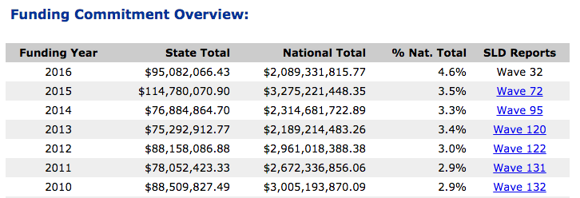
North Carolina Commitments

Slide 3
South Carolina Commitments

Slide 4
Tennessee Commitments

Slide 5
Virginia Commitments

Slide 6
Increased cost for “legacy” service
If your discount is… | Then your voice discount will be:
 | FY 2015 | FY 2016 | FY 2017 | FY 2018 | FY 2019
20% | No Funding | No Funding | No Funding | No Funding | No Funding
25% | 5% | No Funding | No Funding | No Funding | No Funding
40% | 20% | No Funding | No Funding | No Funding | No Funding
50% | 30% | 10% | No Funding | No Funding | No Funding
60% | 40% | 20% | No Funding | No Funding | No Funding
70% | 50% | 30% | 10% | No Funding | No Funding
80% | 60% | 40% | 20% | No Funding | No Funding
90% | 70% | 50% | 30% | 10% | No Funding

Slide 7
Alternatives to Traditional Voice
VoIP
Owned Solution
SIP/Trunk and/or PRI
Hosted
Microsoft Link or Google Voice
Items to Think About When Considering VoIP

Slide 8
NCREN costs
Internet
$20M in 2016
Content Filtering and Firewall
Separate cost
Request for funds from GA?
Share costs with LEAs and Charters?
Still under discussion

Slide 9
WAN Amounts
Over $11M in 2016
Share costs with LEAs and Charters?
Still under discussion

Slide 10
Alternative to Lit Fiber?
Modernization Order allows for
Dark Fiber, including DF w IRU
Self Provisioned
Lit, DF, DF IRU and Self Provisioned may all have special construction
School Connectivity Fund
Identified as an eligible source for state “matching” fund

Slide 11
Alternatives to Lit Fiber?
There is an inordinate amount of paperwork, questions and waiting involved
Craven Co (Self Provision with special construction)
Caswell Co (Dark Fiber with special construction)
Maintenance and Operations Contracts
Fiber must be “lit”
Within the funding year it is funded
Could put project in jeopardy if late FCDL

Slide 12
WiFi in your classrooms!
E-Rate Modernization Yields Results in North Carolina
Report to the North Carolina General Assembly (pdf)
School Connectivity Initiative 2016 Legislative Report (slide deck)
Shoutout to Phil Emer and Ray Zeisz and all the team members at the Friday Institute for their help, support and guidance!

Slide 13
PRC 073 and PRC 036
Once the C2 app is funded
DPI will drop the non-discounted portion to
PRC 073 for LEAs
PRC 036 for Charter schools

Slide 14
The E-rate Process
This Is Not For The Faint Of Heart …

Slide 15
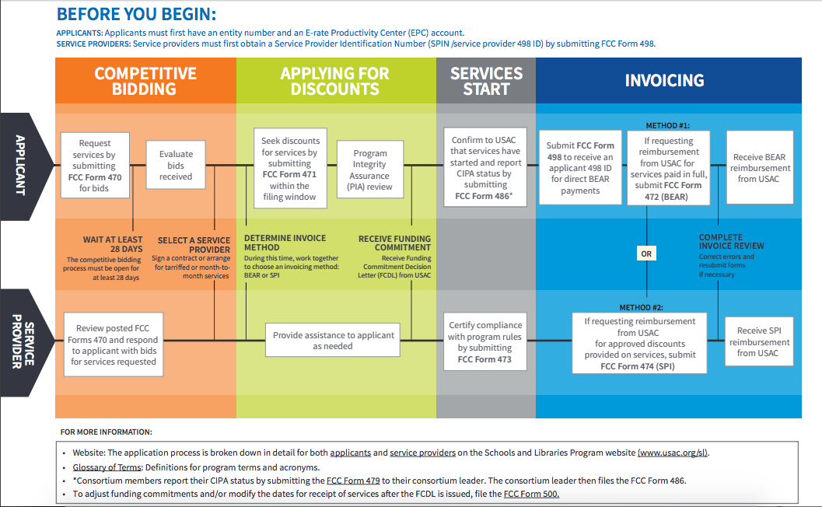
E-rate Process

Slide 16
Competitive Bidding
Help your CTO/Tech Director
Share policies on procurement
Advertising
RFP
Disqualification factors
BAFO language
Receiving and evaluating bids
Choosing vendors and signing contracts

Slide 17
Competitive Bidding
Documentation Requirements
Board minutes of contract signature
Minutes of meeting where bids are discussed including copy of calendar
Evaluation matrix
Winning and losing bids
Copies of letters to losing vendors
Signed contracts

Slide 18
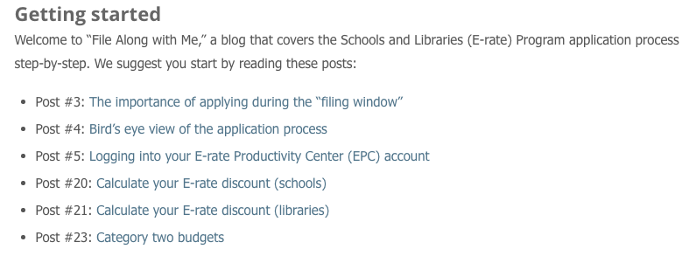
File Along With Me
Blog entries from 2016 Filing Season
Start Here

Slide 19
Payments
BEAR vs SPI

Slide 20
Service Provider Invoicing
Why pay 100% of the invoice when you can pay the non-discounted portion?
WiFi projects set up for SPI billing
Quote and/or Item 21
PO
Invoice

Slide 21
Direct Deposit for BEAR
Form 472, BEAR, is now a direct deposit to the applicant’s bank account
CFO must have a role in EPC
Form 498 – completed by “School or Library Official”
Upload “proof” of banking information

Slide 22
Data Needed
Banking Information
Bank Name
Ban Routing Number
Bank Account Number
DUNS
Dunn and Bradstreet Number
Taxpayer ID
TIN or EIN

Slide 23
Follow Up Documentation
498 Bank Verification
Voided check
Data on bank letter head
Upload to:
https://efile.universalservice.org/ContributorManagement/V1/BankValidation

Slide 24
Audits
Sample Checklists

Slide 25
From USAC Audit Division Staff
Documentation for Auditors Checklist:
http://usac.org/_res/documents/sl/pdf/audit/Audit-PDF.pdf
Common Audit Findings
Schools and Libraries Program section that outlines common findings and some ways (including some examples) to prevent these types of findings of occurring in the future:
http://usac.org/about/about/program-integrity/findings/common-audit-sl.aspx

Slide 26
Reading the FCC Tea Leaves
And Other Congressional Issues

Slide 27
The Modernization Orders
FCC may be backing off self-provisioning
“We don’t want to fund duplicative networks”
“We are not sure USAC has the expertise to evaluate”

Slide 28
Modernization Report
Order issued to “retract” the
E-rate Modernization Progress Report
Chairman Pai’s response to Sen. Nelson

Slide 29
Infrastructure Requests
48 US Senators to Trump: Any Infrastructure Plan Must Include Broadband

Slide 30
Voice?
Ex Parte by Rural Broadband Association (NTCA) and TDS Telecom asking:
A study to advocate for the Commission to conduct an E-rate support applicant study of the voice phase down due to the E-rate Modernization Order.
study would “enable schools and libraries to demonstrate the consequences of the voice support phase down on their operations and budgets.”
pause the voice phase down
restore the voice phase down levels to FY 2014 for support for voice services on a temporary basis while the FCC studies this further.

Slide 31
Data Sources
Free Data Tools

Slide 32
Data Sources
USAC Tools
2015 and prior years – Data Retrieval Tool
2016 going forward – Funding Request Status Tool
Entity Download Tool

Slide 33
Other Tools
E-rate Central
State Information
Funds For Learning C2 Budget Tool
This is for 2015 only!
https://www.fundsforlearning.com/schoolDistCalculator.php

Slide 34
Compare and Connect Tool
Education Super Highway
http://www.compareandconnectk12.org
Tool is sensitive to browser!

Slide 35
School Connectivity Contacts
Michael Ramsey, Network Analyst and Team Supervisor
Jeannene Hurley, State Application and E-rate Specialist for Northeast, North Central, Southwest and Western
Rebecca Martin, E-rate Specialist for Southeast, Sandhills, Piedmont-Triad and Northwest

Slide 36
Questions?

