Slide 1
Data Analysis with Excel
Power BI Tools with Excel 2013
Ken Gibson

Slide 2
Data Analysis
Most people are NOT Data Analysts
We need simple tools that help us
Make decisions
Tease out answers and /or new questions!
Create visualizations
Our data needs to tell a story
A good visual can say things that are lost otherwise
Organizations that build modern information management systems will outperform their peers financially by 20% - Gartner, Mark Beyer, “Information Management in the 21st Century”

Slide 3
Who Should Look at Data? Everyone!
When many eyes are looking into the data, a host of new questions come from the new perspectives.
School leaders
Faculty
Any stakeholder involved in creating efficiency

Slide 4
Grids are Old School!

Slide 5
There is a Better Way…

Slide 6
Excel Data Analysis Tools
We need tools that we already know.
Something that we are comfortable using.
Tools that do not require a degree, but creativity!
We need tools that will help us tell a story.
Give users a live interactive dashboard that contains the metrics they are looking for.

Slide 7
From Data Grids

Slide 8
Interactive Dash Boarding

Slide 9
From Data Grids

Slide 10
Interactive Dash Boarding

Slide 11
Excel 2013 -Power BI Tools
Power Query – (Free Download) – Allows us to discover our data.
Power Pivot – Creates new ways to analyze our data.
Power View – Available in Office 2013. Allows us to visualize our data!
If we can SEE our data… We are better equipped to not only make decisions, but it gives us insight to ask new questions!

Slide 12
Some Basic Excel Tools
Sort and filter
Organizing and weeding out
Conditional formatting
Immediately highlight values
Connecting to other data sources
The answers are out there… And we can get them!

Slide 13
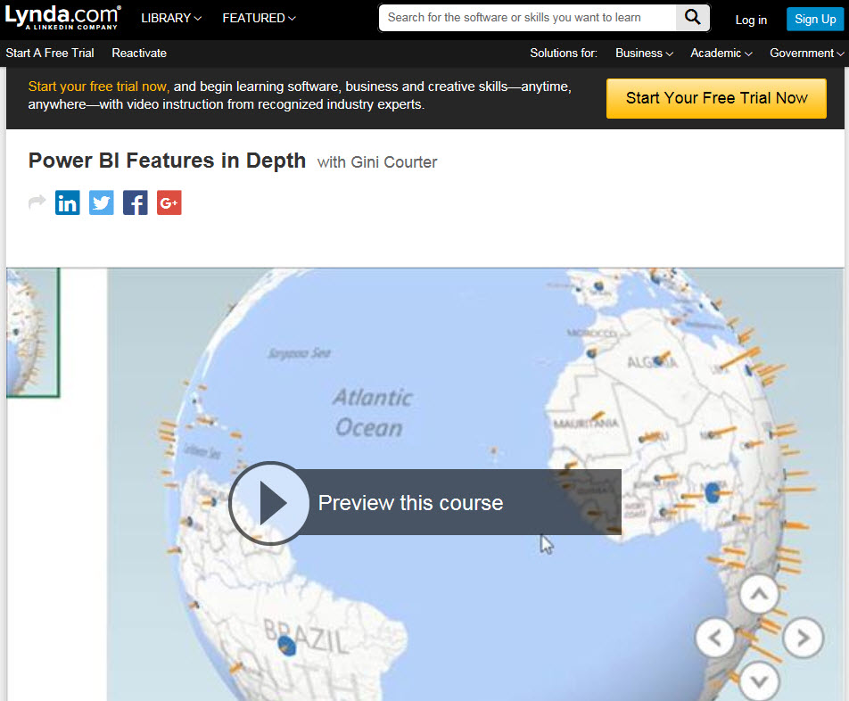
Resources
Google Search Excel Power View Tutorial
Lynda.com
Microsoft - http://social.technet.microsoft.com
Power View Overview

Slide 14
Demo
Lets get into some examples

Slide 15
Thank You Questions
Ken Gibson - gibsonk@pasd.com

